Slide 1
Financial Aid:
What you need to know
Enrollment Services
Enrollment Services Advisor

Slide 2

Topics We Will Discuss
What is financial aid?
Cost of attendance (COA)
Student Aid Index (SAI)
Financial need
Categories, types, and sources of financial aid
Free Application for Federal Student Aid (FAFSA®)
Unusual and Special circumstances

Slide 3

What is financial aid?
Financial aid consists of funds provided to students and families to help pay for postsecondary educational expenses

Slide 4




What is Cost of attendance (COA)?
Tuition and fees
Housing and Food
Books and supplies
Transportation
Miscellaneous personal expenses
Notes:
The COA is an estimate of the expenses students can expect to incur while attending university or college. There are five elements included in a COA: tuition and fees, housing and food, books and supplies, miscellaneous costs, and transportation. Each student’s actual expenses will differ depending on personal choices, residency, and/or enrollment.

Slide 5
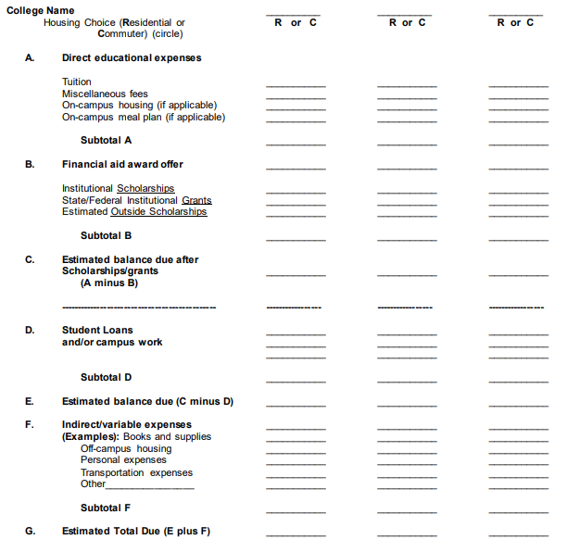
Cost Comparison
A worksheet like this can be used as a guide to calculate a student expense budget and to help determine the resources needed to meet the costs for the school year when comparing colleges.
Notes:
The cost of attendance is different for each one. This way you can compare the three more effectively. Your financial aid package at the private school might be more substantial, but generally so is the cost. When you use a tool like this one, you can also compare the costs and see just how far your financial aid will go.

Slide 6
What is the Student Aid Index (SAI)?
Number resulting from the evaluation of a student’s (and family’s) approximate financial resources for a student’s postsecondary education
Student contribution
Contributor
Parent
(for dependent students)
Notes:
The Student Aid Index (SAI) is an eligibility index number that a college's or career school's financial aid office uses to determine how much federal student aid the student would receive if the student attended the school. This number results from the information that the student provides in their FAFSA® form.

Slide 7
What is financial Need?
Cost of attendance (COA) – Student Aid Index (SAI) = Financial need
Notes:
F I N A N C I A L N E E D : The SAI and other resources are subtracted from the COA in order to determine “financial need”. The Office of Financial Aid provides a financial aid package consisting of aid based upon students’ eligibility and availability of funds. Financial aid cannot exceed the cost of attendance in most instances.

Slide 8
Types of Financial aid
Scholarships
Grants
Work-Study Employment
Loans
Self-Help
Aid
Gift Aid
Notes:
There are four basic types of financial aid: grants, scholarships, work-study, and loans. Grants and scholarships are considered “gift aid” and are not generally required to be repaid, work-study is paid to students based on employment, and loans are funds that must be repaid with interest.
Federal Pell Grant
Federal Supplemental Education Opportunity Grant
Work-Study: This award is available to qualifying undergraduate students who demonstrate financial need as determined by EFC. Work-study funds are limited; for consideration, students must submit their FAFSA by the December 1 priority FAFSA filing date. After accepting the offered award, students may earn up to the awarded amount during the academic year. Upon obtaining employment the student’s work schedule is arranged with the student’s supervisor.
Direct Stafford Loans; Subsidized and Unsubsidized
Parent Plus Loan: Available to parents of dependent undergraduate students who are enrolled at least half-time in a degree seeking program. Either biological or adoptive parents may borrow on behalf of a student; stepparents may only borrow if their information was provided on the FAFSA. The parent borrower must pass a credit check conducted by the U.S. Department of Education. The parent may borrow up to the student’s remaining COA after financial aid and other resources have been subtracted. Interested parents should begin the application process at studentaid.gov. Parents who wish to apply for a Parent PLUS loan may do so no earlier than July 1 for the upcoming fall term. Additional information is available on the Federal Direct Parent PLUS Loan section of our website.
Alternative/ P R I VAT E L O A N : Private loans are credit-based loans for undergraduate students/parents who are seeking additional financial assistance. These loans can vary in terms, conditions, interest rates, and eligibility requirements. We strongly encourage students and parents to exhaust all other financial aid options before applying for alternative/ private loans

Slide 9
Sources of Financial Aid
Federal Government
Employers
States
Private Sources
Colleges and Universities
Notes:
Common resources are outside scholarships, ROTC, AmeriCorps proceeds, tuition and/or fee waivers, athletic grants, Vocational Rehab, Resident Assistant programs, etc

Slide 10
Free application for federal Student aid (FAFSA)
May be filed at any time during an academic year, but no earlier than October 1st prior to the academic year for which the student requests aid
For the 2025-26 academic year, the FAFSA may be filed beginning December 2024 and will ask for the 2023 tax return information
Each college/university has their own priority aid deadline
Wright State’s FAFSA priority deadline is February 1, 2025 for the 2025-2026 Aid year
Notes:
The latest that we are hearing from the US Department of Education, in regards to the 25/26 FAFSA release date, is that they will go with a soft release in October, and it will be fully released by December 1, if not before. It is my understanding that this soft opening means that certain people who have an active FSA ID will be invited to complete their 25-26 FAFSA as soon as October 1. If I were filing the FAFSA with my daughter this year, I would wait until December 7th to file the FAFSA. Wait until after the full release to file, when they have supposedly gotten all of the kinks out.

Slide 11
Who Should Complete the FAFSA
Citizenship
Enrollment
Student
Be a US citizen or an eligible noncitizen;
Have a valid Social Security number (with some exceptions
Be enrolled or accepted for enrollment as a regular student in an eligible degree or certificate program;
Be enrolled at least half-time to be eligible for Direct Loan Program funds
  Undergraduate 6 credit hours
  Graduate 3 credit hours
Having a high school diploma or a recognized equivalent such as a General Educational Development (GED) Certificate;
Completing a high school education in a homeschool setting approved under state law; or
Enrolling in an eligible career pathway program and meeting one of the “ability-to-benefit” alternatives can apply in certain situations
Info about eligibility: StudentAid.gov/eligibility
Notes:
have a valid Social Security number (with the exception of students from the Republic of the Marshall Islands, Federated States of Micronesia, or the Republic of Palau
enrolling in an eligible career pathway program and meeting one of the "ability-tobenefit" alternatives can apply in certain situations including for non-U.S. citizens, students with criminal convictions, and students with intellectual disabilities

Slide 12
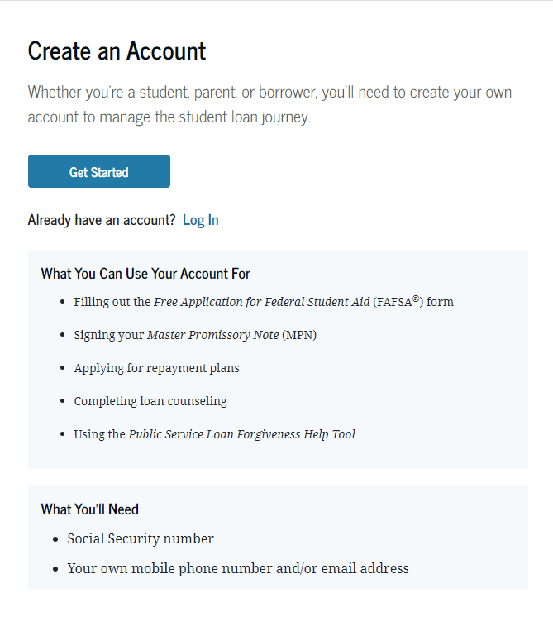
Account Username and Password (FSA ID)
Used for FAFSA completion
and access to certain U.S. Department of Education websites
Student and parent must
create own FSA ID
May be used throughout
financial aid process,
including subsequent
school years
Only the owner should
create an FSA ID
Notes:
Anyone who provides information on the FAFSA (Student, Student Spouse if married, parent, other parent if parent of record is married) are called contributors, and all contributors MUST provide the required information and sign the respective section of the FAFSA. It is recommended that all possible contributors create an FSA ID.
If parent created their FSA ID the same day, or day before, filing the FAFSA they will be prompted to enter the financial information manually. After consent is given and the FAFSA submitted, once the FSA ID is verified by SSS & Homeland, the US Dept of Ed. will automatically make a correction to pull the tax in to the FAFSA, and override the tax information entered manually.
Signature Page is no longer available.

Slide 13


Free Application for Federal Student Aid (FAFSA®)
Online FAFSA
PDF FAFSA
Notes:
Benefits of using the Online FAFSA –
Built-in edits to prevent costly errors
Skip-logic allows student and/or parent to skip unnecessary questions
No need to manually enter federal tax information (FTI)
More timely submission of original application and any necessary corrections
More detailed instructions and “help” for common questions
Ability to check application status online
Simplified application process

Slide 14
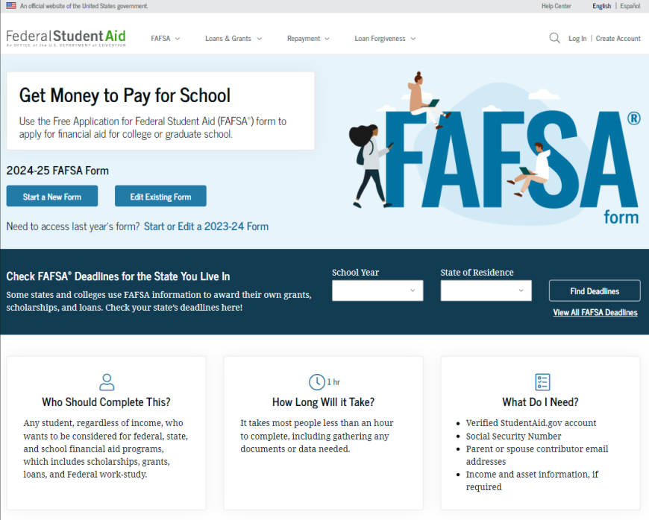
Online FAFSA

Slide 15

When to complete your FAFSA
Year
1
Year
2
COMPLETE YOUR FAFSA
EVERY YEAR
MUST FILE
High School Senior Year and every year in college
The 25-26 Free Application opens in December 2024.
Year
3
Year
4
Notes:
This slide is to simply let you know that you should be filing your FAFSA starting in your Senior Year in High School for you first year in college, and each year you are enrolled in classes until you graduate.
It is also important to note that an incomplete FAFSA will be deleted after 45 days of inactivity. Inactivity in this case is defined as one that is started, not submitted, and abandoned (no activity in 45 days). Once an invitation is ‘sent’ they will receive reminder emails every seven days during that day period until the FAFSA is submitted.
Example: The dependent student has two additional required contributors. The student starts and completes their section. One parent starts and completes their section, and identifies another parent (stepparent) who is required to complete the FAFSA. The student and parent 1 complete their sections, but the stepparent doesn’t. The FAFSA will be deleted after 45 days of inactivity from any of those contributors. So, if parent 1 was the last to enter and save the FAFSA, and no activity happens after 45 days from them, it will be deleted. Everyone will have to start over.

Slide 16
FUTURE Act Direct Data Exchange (DDX)
FA-DDX is the system used to transfer individuals tax information to determine federal aid eligibility (replaces what used to be the IRS data retrieval tool DRT)
Reduces documents requested by financial aid office
If a person did not file a federal tax return, it will report that information
Consent is required by all contributors on FAFSA
Notes:
What is the Future Act for FSA?
The FUTURE Act amended the Internal Revenue Code (IRC) to mandate the disclosure of FTI directly from the IRS to the Department with an individual's approval and consent. The FUTURE Act also made providing consent for the exchange of FTI a requirement for receiving federal student aid.
IRS transfers information to populate FAFSA income questions for most tax filers
Eliminates manual entry of tax and income information

Slide 17
What Parent to include on the FAFSA
Effective with the 2024-2025 year, the contributor criteria changed for students with divorced or separated parents not living together.
The student must include the parent on the FAFSA who provided the greater portion of the student’s financial support in the 12 months prior to filing the FAFSA even if student does not live with that parent.
If neither parent provided support in that 12-month period, include information for the parent who provided the greater portion of support during the most recent year the student received financial support.
If both parents claim equal amount of support, the parent with the greater amount of income or assets is the contributor.

Slide 18
Who Is Included in Family Size?
Dependent Applicants
Student
Independent Applicants
Parent (and spouse)
Parent’s dependent children, even if they live apart from the parent because of college enrollment*
Other people if they live with the parent*
Student (and spouse)
Student’s dependent children, even if they live apart from the student because of college enrollment*
Other people if they live with the student*
* Included only if providing more than half of their support between July 1, 2025 and June 30, 2026

Slide 19
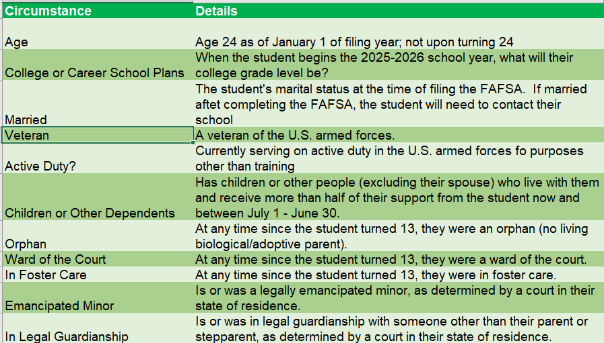
Student Personal Circumstances

Slide 20
Unusual Circumstances
Conditions that justify an institution making an adjustment to a student’s dependency status
Student does not provide parental data on FAFSA
    Considered provisionally independent
Student follows institution’s process for dependency override determination
Notes:
If student posts to FAFSA that parent refuses to file FAFSA, student can mark their FAFSA that way, but they will not be eligible for need based aid – Grants, Federal Work-study, Scholarships.

Slide 21

Special Circumstances
Unusual uncovered medical/dental expenses
Secondary school tuition
Extraordinary dependent care
Parent or spouse death
Additional family members in college
Loss of employment or income
Divorce
Notes:
Different than unusual circumstances (dependency overrides)
Unique conditions exist that cannot be documented with the FAFSA, or circumstances have changed since filing
Student should contact institution’s financial aid office for more information
Decisions are final and cannot be appealed to U.S. Department of Education
Changes to your Financial Aid award: Certain situations can cause changes to a student’s financial aid award during the academic year.
Verification
Professional Judgement Appeals
Enrollment Changes

Slide 22
Scholarships
Institutional Scholarships
Find out from the office of Financial Aid at your school how to apply for scholarships, and the submission deadline.
Inquire when awards will be made and how students will be notified of awards
External (Private) Scholarships
Scholarships offered by donors/foundations outside the university
Can be offered Employers, communities, or other organizations
Can be based in anything
Smaller Scholarships add up
Notes:
Scholarships are awarded based on academic criteria and/or any combination of academics, financial need, campus/community activities, leadership positions, and work experience. Scholarships are designed to reward, encourage, and assist students in pursuing academic success
RECEIVING OUTSIDE SCHOLARSHIPS: Federal regulations require students who receive financial assistance through additional sources to notify the financial aid office of their award.
Wright State’s Scholarship application deadline is now February 1, 2025 for the 2025-2026 Aid year

Slide 23

External Scholarships
Cappex.com/scholarships
Chegg.com
Collegeboard.com
Collegenet.com
Fastweb.com
Niche.com
Salliemae.com
Scholarships.com
Unigo.com

Slide 24

How much federal student aid can I get?
Maximum amounts for the major programs for a dependent student in 2024-25:
Federal Pell Grant: $7,395
Federal Work-Study: depends on funds available at school
Direct Subsidized and Unsubsidized Loans:
  $5,500 total for a freshman (0-29 earned credit hours)
  $6,500 total for a sophomore (30-59 earned credit hours)
  $7,500 total for a junior or senior (earned over 60 credit hours)
Direct PLUS Loan (for parents): COA minus other aid received
Financial aid cannot exceed the COA (Cost of Attendance)

Slide 25

Where can I get more info?
StudentAid.gov
  Info about aid programs
  Links to free scholarship and college searches
1-800-4-FED-AID or studentaid@ed.gov
  Info about aid programs
  Help with FAFSA form
Online Chat function through the FAFSA

Slide 26

Why do I need my child’s permission to view financial award packages when I’m the one paying for my child’s education?
To comply with the Family Educational Rights and Privacy Act of 1974 (FERPA), students age 18 and older must give written consent to release their education records to outside parties, including their parents. These records include, but are not limited to, financial aid, scholarships and fellowships, and student account/billing information.
Notes:
FERPA The FERPA regulations extend to all forms of communication including email, phone calls, and in person communications. Students who wish to speak to a representative about their accounts can contact Student Account Services through any of these means. Identity verification will be required. Students have the ability to grant authorized access to parents, guardians, or other parties through their Registrar.

Slide 27
What is SAP?
Your Financial Aid Depends on It!
To maintain satisfactory academic progress (SAP), undergraduate students and graduate/doctoral students must meet certain requirements. All students enrolled in courses will be evaluated for SAP. This includes courses taken while not receiving Title IV financial aid.
SAP Requirements
  Cumulative G.P.A. (2.0)
  Completion Rate (67% Rule)
  Maximum Timeframe (150% Rule)
* If you plan to attend the school through which you have earned CCP credits, your SAP has already begun
Notes:
This is the federal minimum for Satisfactory Academic Progress, please check with your school of choice to see what their SAP standards are.

Slide 28

Tips for success
Start checking your college email account daily
Contact the Financial Aid office if dropping or adding a class
Contact The office of Financial Aid regarding special circumstances
  Loss of Income
  Extraordinary Expenses
  Other special or unusual circumstances
Visit StudentAid.gov website for more info on…
  Types of Financial Aid
  Loan history
  Processes and procedures
Notes:
To Do Lists: Verification, required documents etc.

Slide 29

What’s on the Academic Calendar?
Deadlines
  Graduation applications
  Add/Drop dates
  Refund period
  Need Instructor approval to add class
Registration dates and deadlines
Last day to purchase or cancel optional fees
Holidays

Slide 30
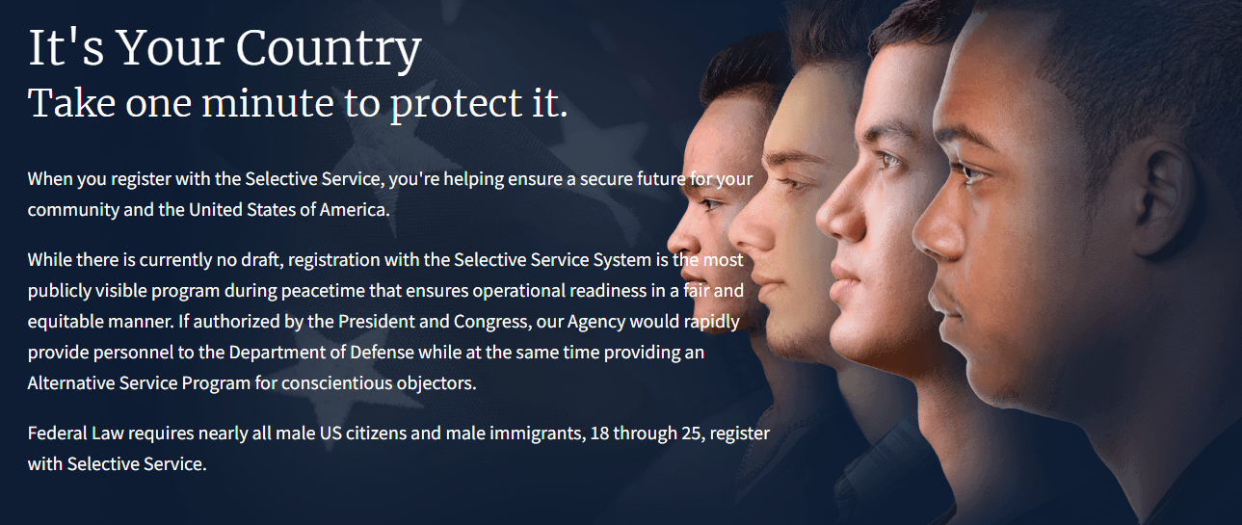
Register for Selective Service
All male US citizens and male immigrants ages 18 – 26 must register with Selective Service
State law says that a university or college that enrolls a male student born after Dec. 31, 1959, who has not filed a statement of selective service status with the university, must charge the student any tuition surcharge who are not in-state residents, regardless of the student's residency

Slide 31

Take Flight Program at Wright State University for Fall Admissions
To be considered for the program, students must meet the following:
  Enroll at Wright State University's Dayton campus directly from high school as a first-time, full-time student for Fall 2025
  Be an Ohio resident and meet all other requirements to be considered an in-state student
  Have a cumulative high school GPA of 3.2 or higher
  Have a Student Aid Index (SAI) of 2,200 or less as indicated by the FAFSA
In addition to covering the cost of undergraduate tuition, the program also provides the following benefits:
  Personal laptop and computer backpack for each participant
  $100 textbook voucher for each year of participation
  Dedicated success team, including academic advisor, success coach, and career consultant
  On-campus employment through the Federal Work-Study Program (Note: You must have unmet need and satisfy federal requirements for Work-Study eligibility. Participation is contingent on you applying for and being hired by an on-campus employer who participates in the Federal Work Study Program.)
Notes:
Please see our website for additional, up to date information
The Take Flight Scholarship is intended to cover any remaining gap between federal, state, and institutional grants/scholarships and in-state undergraduate tuition.
In-State Tuition
- Federal grants and scholarships
- State grants and scholarships
- Wright State scholarships, grants, and fee waivers
- Tuition-specific Veteran’s benefits
- Other external grants or scholarships designated by the donor to pay for tuition only
= Take Flight Scholarship
Costs for housing, meals, books, supplies, transportation, course fees, lab fees, and personal expenses are not included in the Take Flight program but may be covered by other funding sources. If you are eligible for Take Flight, you may use federally guaranteed student loans, Federal Work-Study monies, and private loans to cover these expenses.

Slide 32




Questions?
Need Help? Contact Us! ☺
Enrollment Services at Wright State University
Hours: 8:30 am-5:00 pm M, T, Th, & F
9:30 am-5:00 pm W
Telephone: 937-775-4000
Our social media presence
Website: www.wright.edu/enrollment-services
Email: enrollmentservices@wright.edu
Wright State RAIDER CONNECT
@Raider_Connect

Slide 33
Thank you for coming!

